Slide 1
Hash Tables II

Slide 2
AGENDA
• Intro to Hash Tables Review
• Collisions
• Load Factor & Resizing
• More Whiteboarding Problems (maybe)

Slide 3
Intro to Hash Tables Review

Slide 4
Collisions

Slide 5
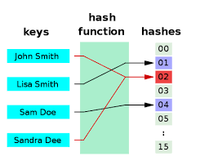
COLLISIONS
• What happens if you try to store values that have the same index?
• Based on our last example you would overwrite the values!
• How can we solve this?
Notes:
Show sample code showing how to implement get

Slide 6
Collisions Demo I

Slide 7
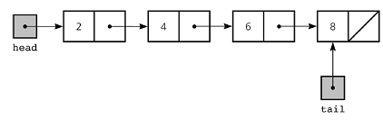
LINKED LIST REVIEW
• Comprised of nodes
• Nodes contain: value, next pointer, previous (if doubly linked-list)
• To fully implement a hash table, we’re combining three things: hashing, arrays, linked lists
Notes:
Show linked list refresher code

Slide 8
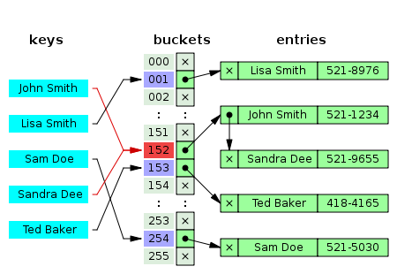
COLLISION RESOLUTION VIA CHAINING
• Operations of a hash table get slower if there are a lot of collisions
• To solve collisions, chain values together by using linked lists
• If a value already exists at that index, add the new item to the linked list

Slide 9
Collisions Demo II
Notes:
Show hash table with collision resolution

Slide 10
COLLISION RESOLUTION VIA LINEAR PROBING
• Keys are stored in the table, instead of storing them in a linked list
• Size of table is >= number of keys
• If a collision occurs, walk the table until you find a free spot
• Tombstone an element when it’s deleted
Notes:
Demonstrate get/store/delete

Slide 11
CHAINING VS. LINEAR PROBING
• Linear Probing has the following benefits:
• Low memory overhead - just need an array and a hash function
• Excellent caching performance - by taking advantage of arrays and cache locality
• Linear Probing has the following drawbacks:
• Gets very slow as load factor approaches 1 (why do you think that is?)
• You can never have more elements than the size of your array
• For the guided project you should use chaining as the collision resolution method
Notes:
Show linked list refresher code

Slide 12
Load Factor & Resizing

Slide 13
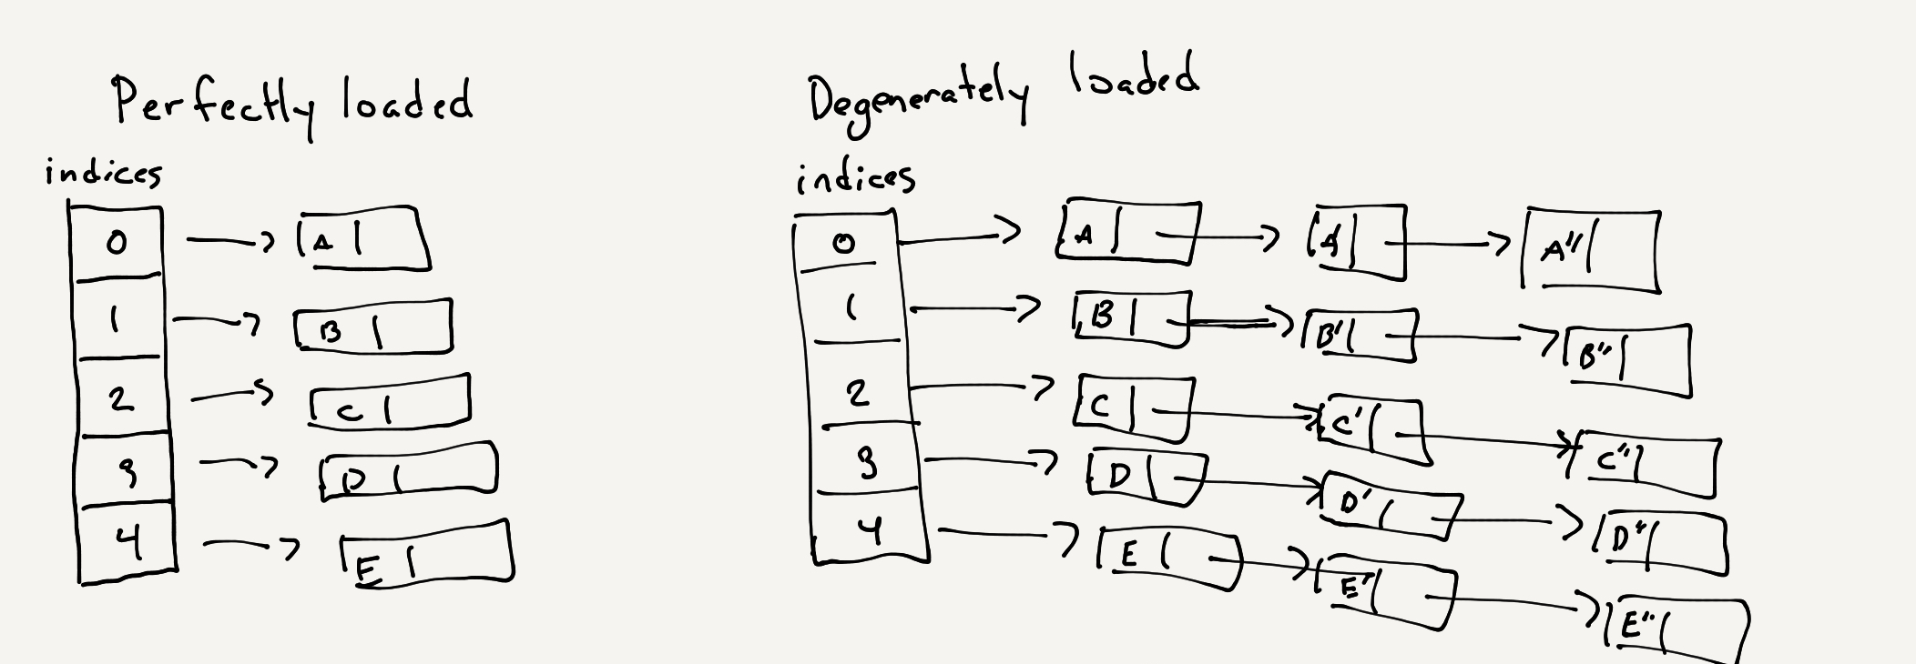
LOAD FACTOR & RESIZING
• The performance of a hash table worsens as there are more collisions
• Can you think of why?

Slide 14
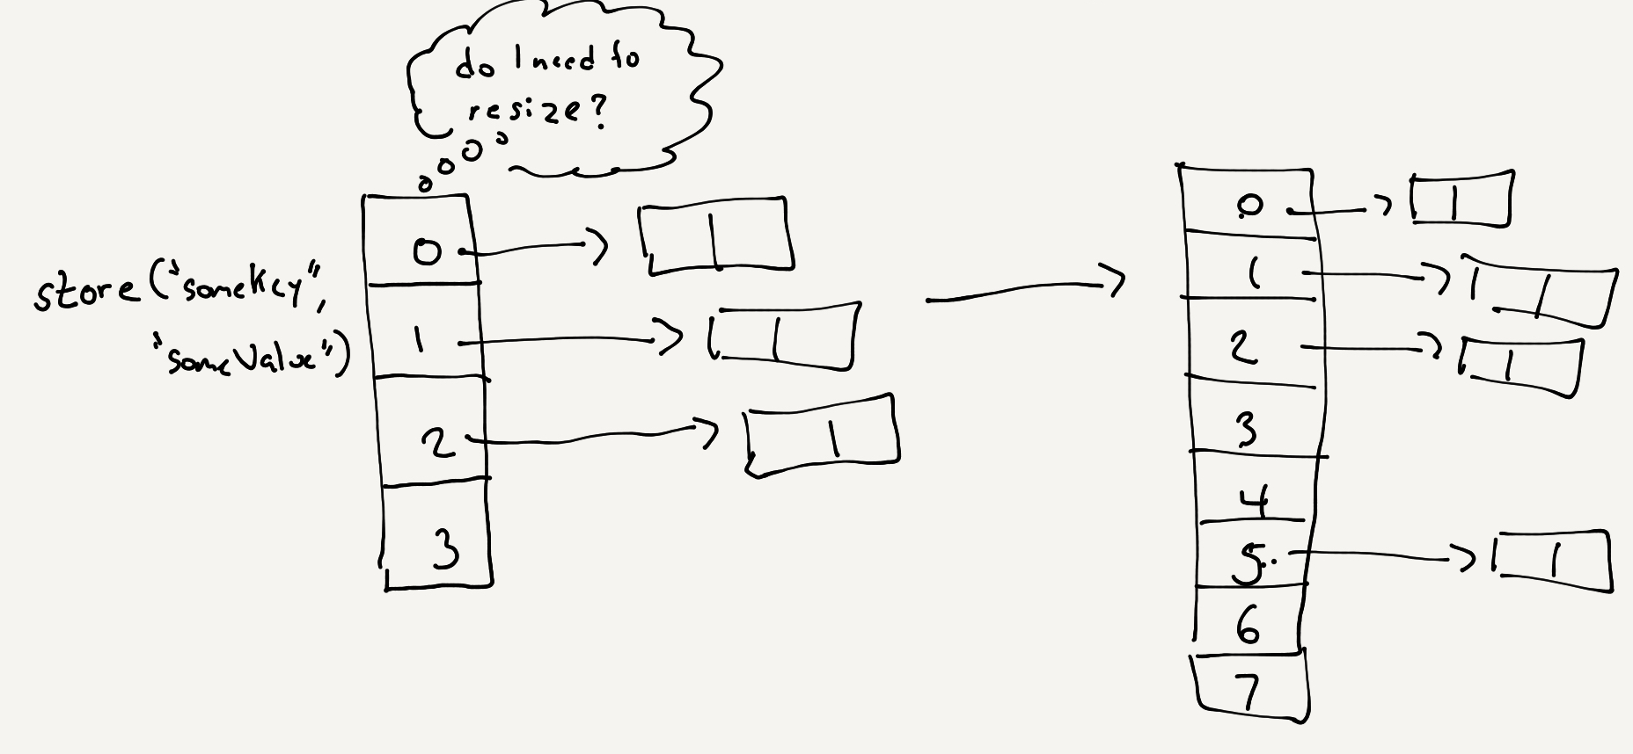
LOAD FACTOR & RESIZING
• To prevent this from happening, we need to know when to increase the size of our table
• Use load factor to determine when to expand/shrink
• Load factor = num elements / num slots
• Expand table if load factor > 0.7
• Shrink if < 0.2
Notes:
Do sample in Paper on deleting values

Slide 15
Load Factor & Resizing Demo

Slide 16
HASH TABLES TIME/SPACE COMPLEXITY
• What’s the time/space complexity of get/store/delete in a degenerately loaded hash table? Perfectly loaded hash table?
 | Average | Worst
Get
Store
Delete
Notes:
Do sample in Paper on deleting values

Slide 17
HASH TABLES TIME/SPACE COMPLEXITY
• Make sure you can explain why!
 | Average | Worst
Get | O(1) | O(n)
Store | O(1) | O(n)
Delete | O(1) | O(n)
Notes:
Do sample in Paper on deleting values

Slide 18
TODAY’S ASSIGNMENT
• Implement a hash table with collision resolution via chaining and resizing based on load-factor
Notes:
Do sample in Paper on deleting values

Slide 19
More Whiteboarding Problems

Slide 20
HASH SET
• Hash tables are used in common data structures (sets, dictionaries, etc.)
• Leetcode Link

Slide 21
Hash Set Demo

